Slide 1
CCAT Introduction
Progress & Snapshots
Jonah Lee

Slide 2
Notes for first week:
https://docs.google.com/document/d/1zxtQVqzwe3t_rQdCg264VINjCktPg0NBKFiZ6sjcy8A/edit?tab=t.0

Slide 3
Glossary
CCAT | Cerro Chajnantor Atacama Telescope
FYST | Fred Young Submillimeter Telescope
BLAST-TNG | Balloon-borne Large Aperture Submillimeter Telescope - The Next Generation
SPIRE | Spectral and Photometric Imaging Receiver

Slide 4
Further Research Areas / Ramp-up
S21 Transmission
KIDs
Review Git Repo - https://github.com/ccat850/map_making_blasttng

Slide 5
S-Parameters
I (in-phase) / Q (quadrature) -- why is S complex?
S-parameters relate steady-state oscillating signals at a given frequency
S₂₁ is the dimensionless coefficient representing the transmission of signal 1 (drive) on signal 2 (sense)
V2 = (S21)(V1) [all values are complex]
V1 and V2 are complex since they are phasors. They have both magnitude and phase.
Naturally, s-parameters are also complex so that they can represent both the gain and phase shift of the transmission.
Algebraically, if S21 = V2 / V1 we see that S21 must be complex for this to be valid for arbitrary V2 and V1.

Slide 6
Kinetic Inductance Detectors - What Are They?
Each detector is composed of a resonator (L-C circuit) and coupling capacitor
Detectors are arranged in lines of ~1024, and each is tuned to a different frequency (this is done by changing the geometry of the components)
Each detector attenuates (dissipates power → heat) near its resonant frequency. The values of the attenuation / resonant frequency are affected by the temperature & flux of photons on the superconducting detector.
At ~100mK temperatures, the effect of photons breaking cooper pairs causes measurable changes in attenuation/frequency, so KIDs can be used to measure light

Slide 7
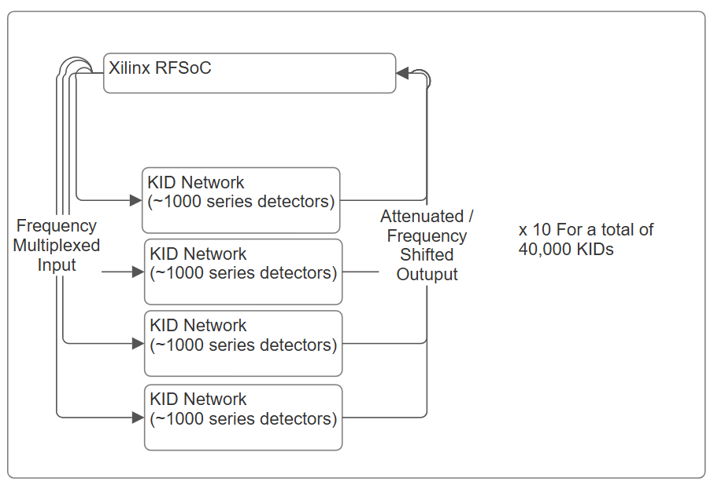
KIDs - How Are They Used?
Prime-Cam 850 GHz module: 40,000 detectors, 1000 KIDs/network (line)
Each Xilinx RFSoC can handle 4 networks
A “tone comb” is used to sweep the frequency spectrum and locate the exact resonances of each KID
Bad KIDs are discarded
Too close together (crosstalk)
Manufacturing Defects (low quality factor)
Fixed Tone
Relatively simple & proven technique for reading KIDs in which the carrier signal contains the superimposed resonance frequencies for each usable detector?
I and Q timestreams for each detector are obtained
From DF/ΔF (change from natural freq.) and attenuation we derive photon flux

Slide 8
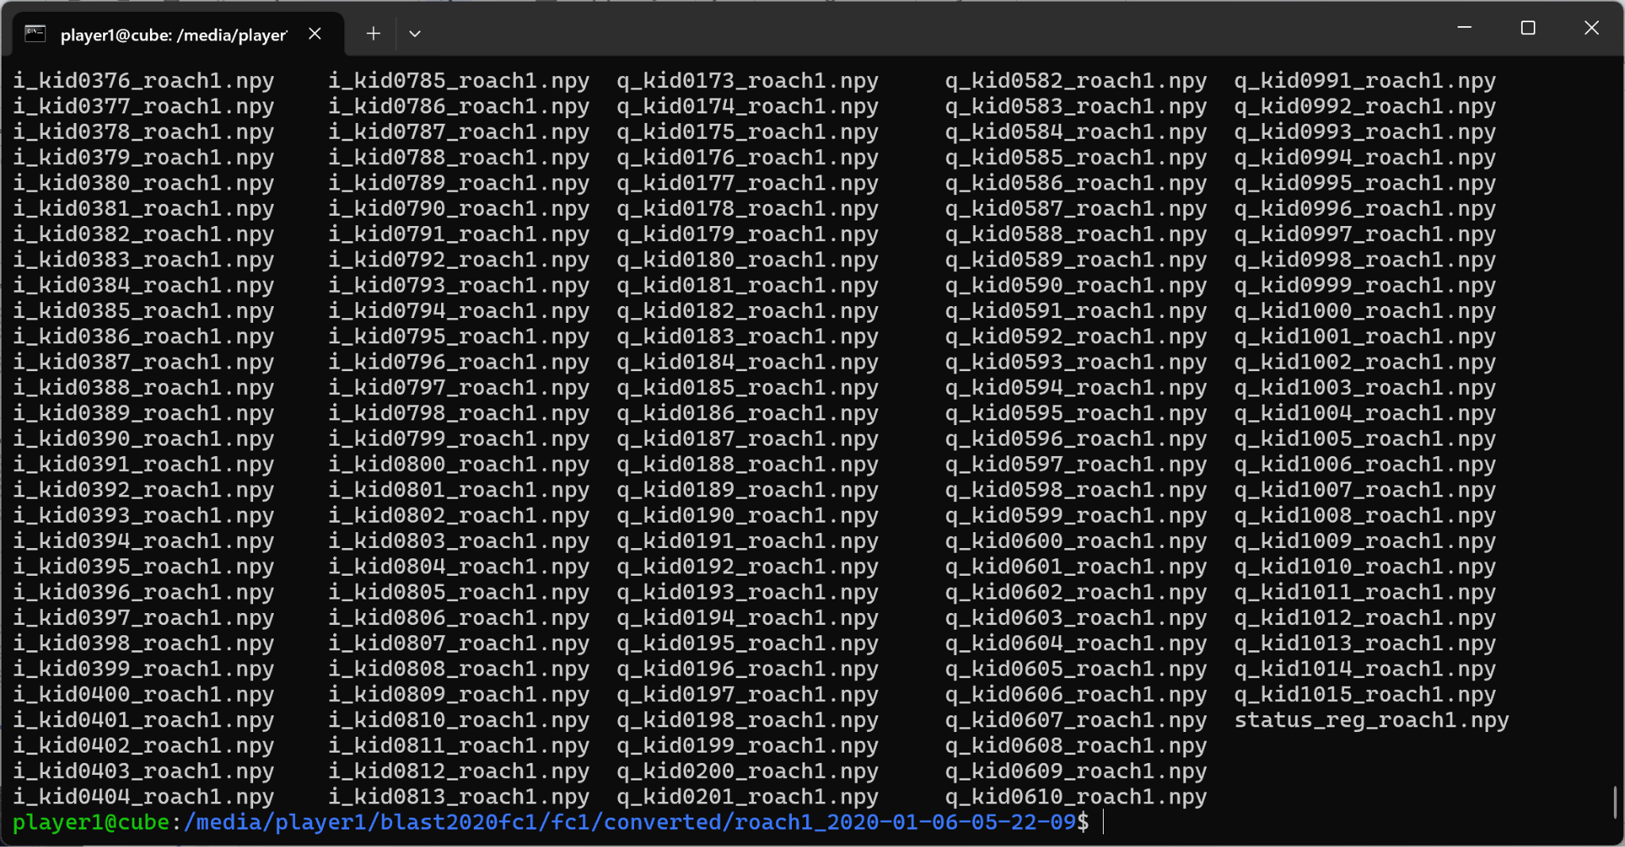
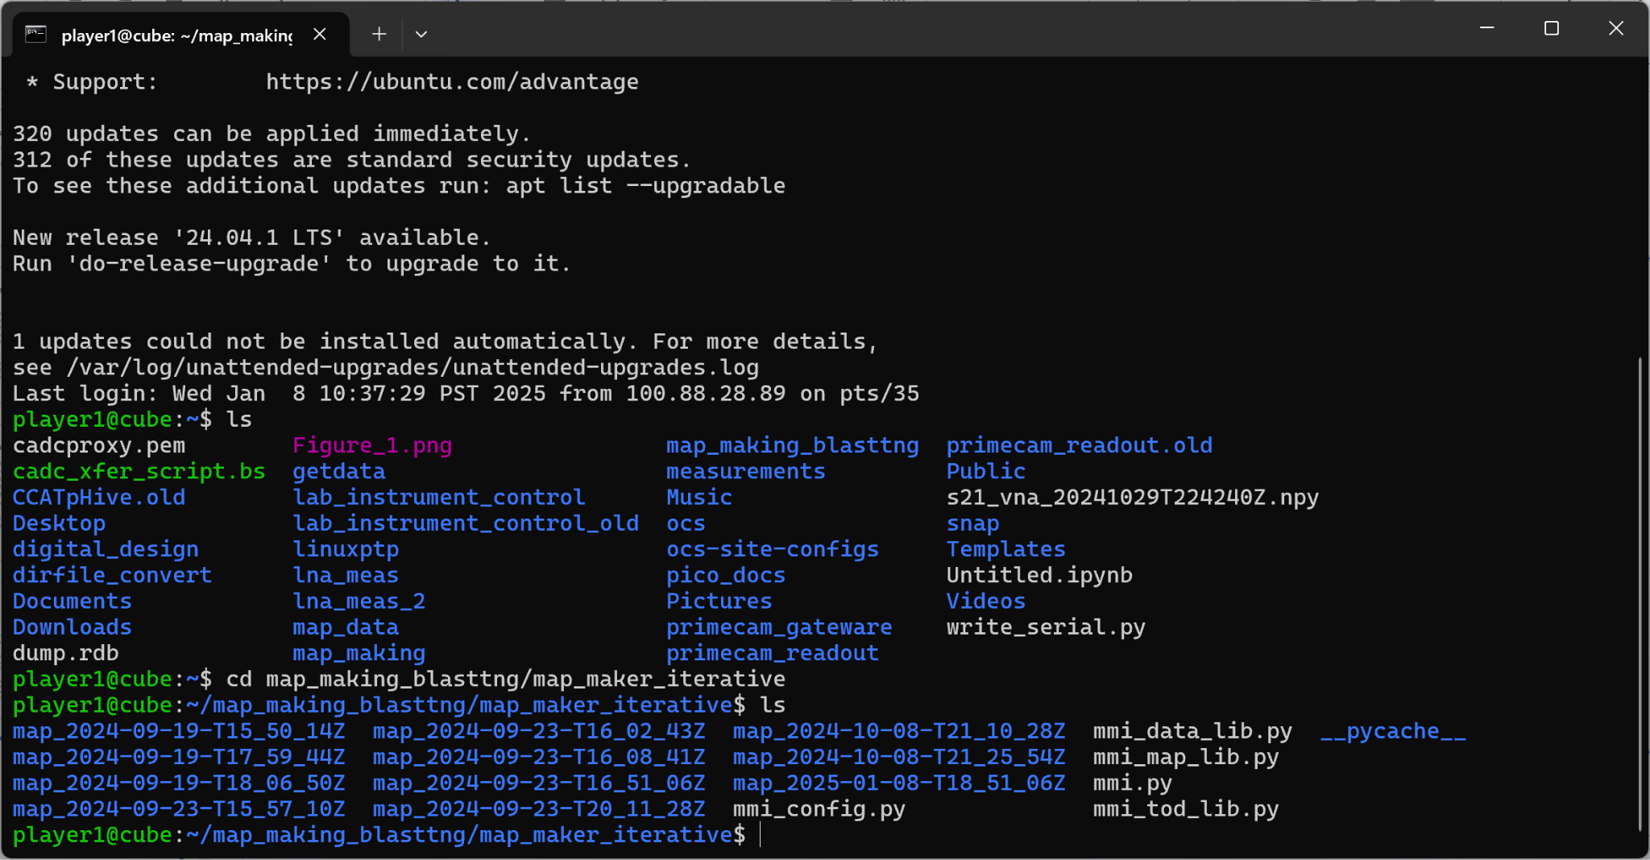
Connecting to the Control Computer

Slide 9
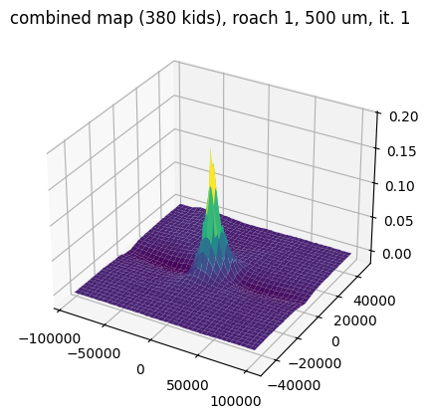
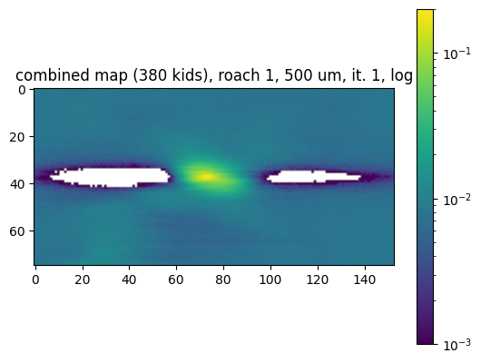
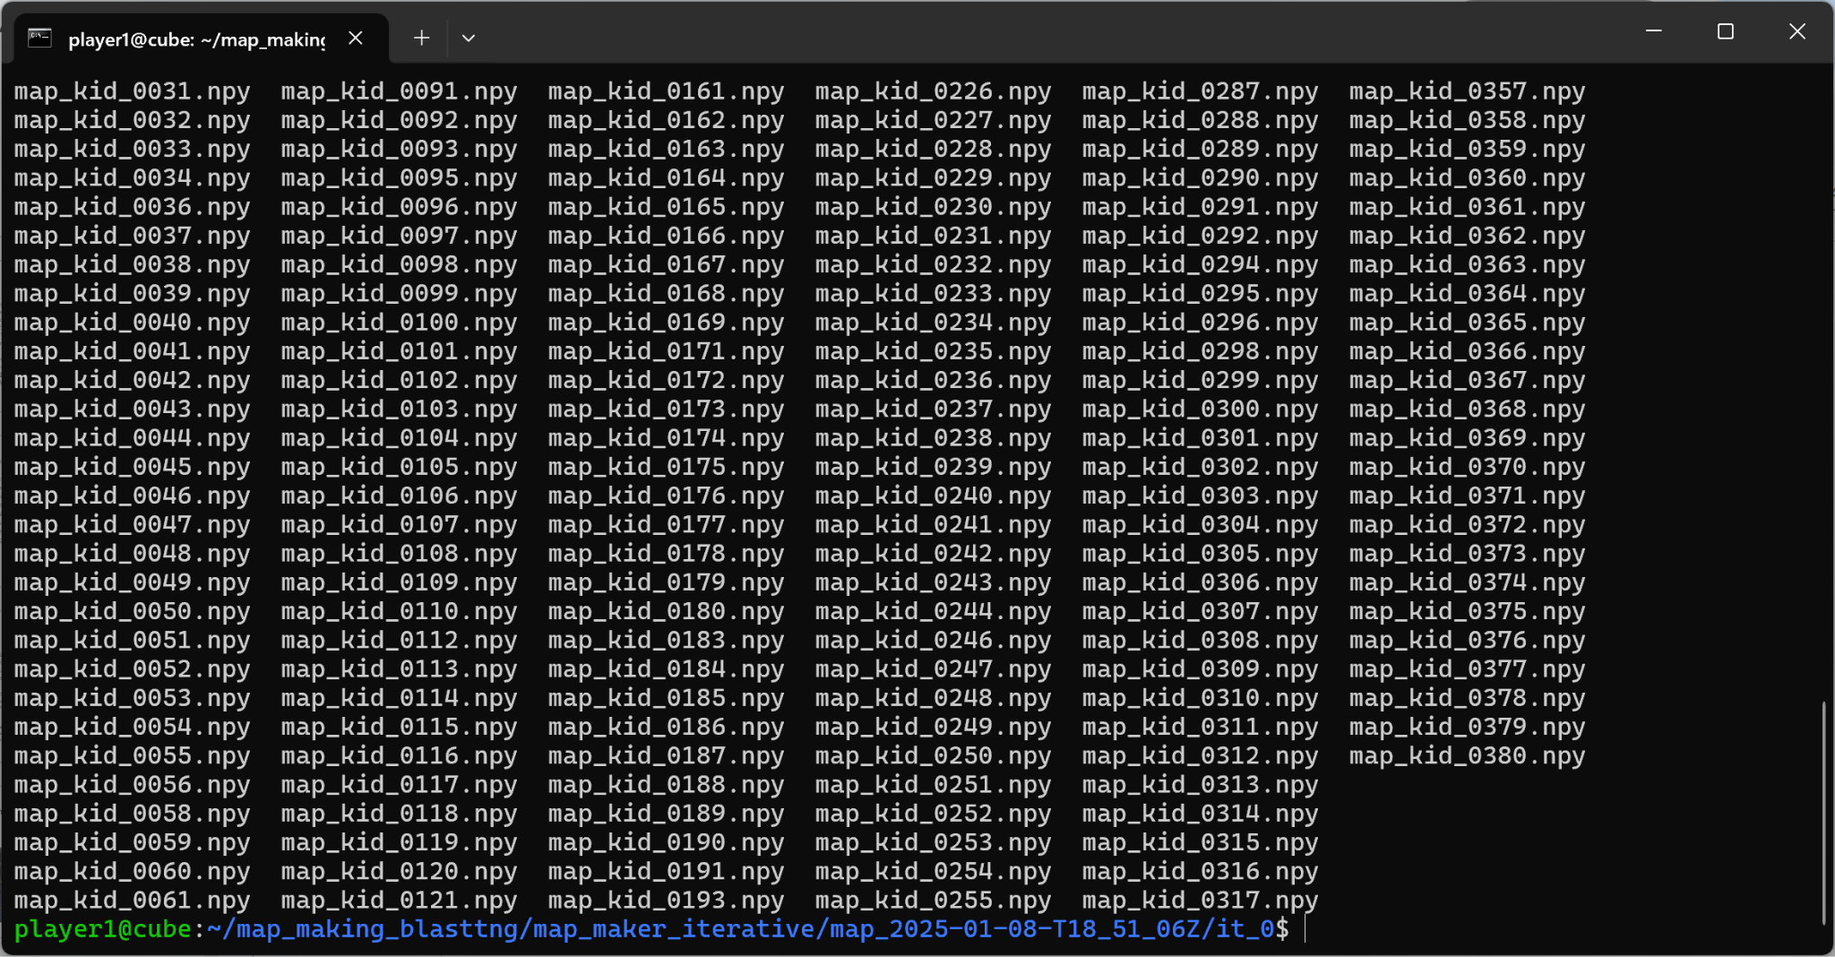
Computing & Displaying Images

Slide 10
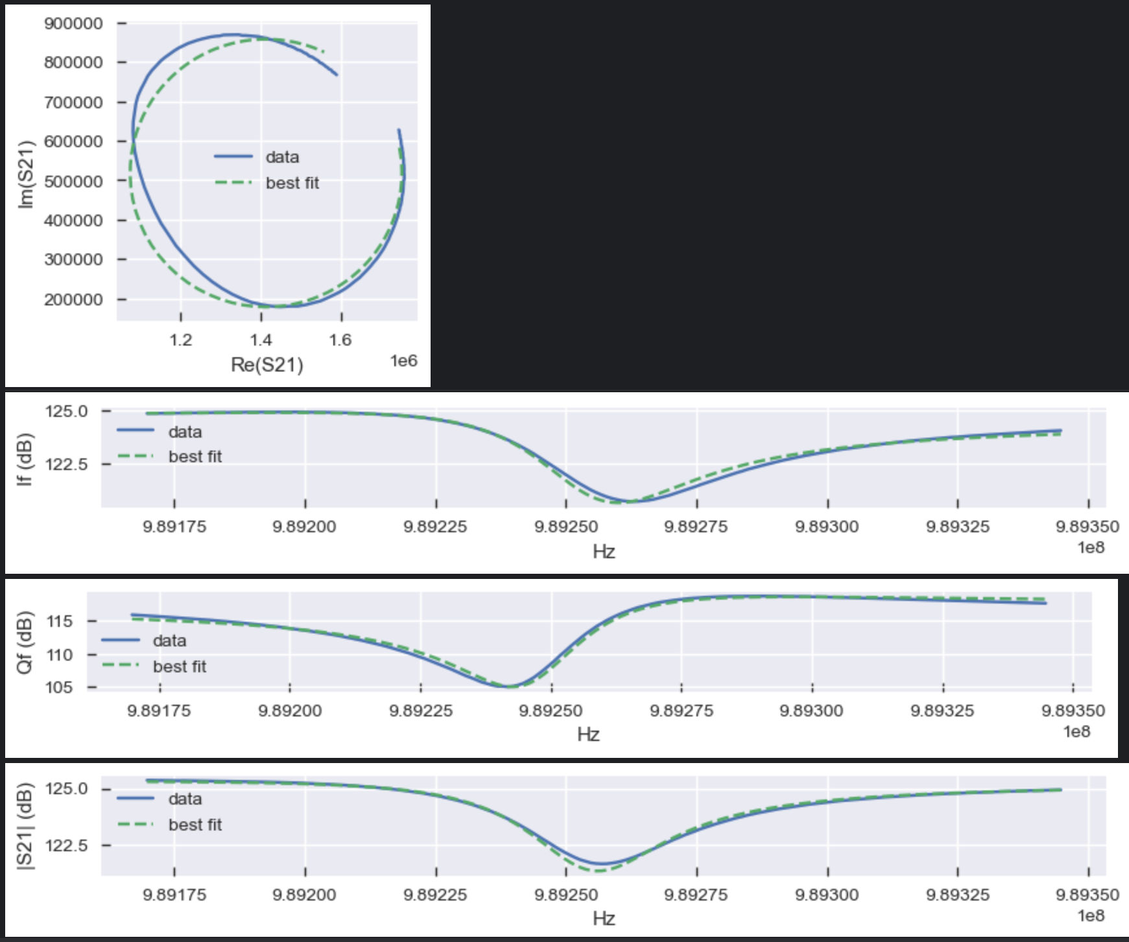
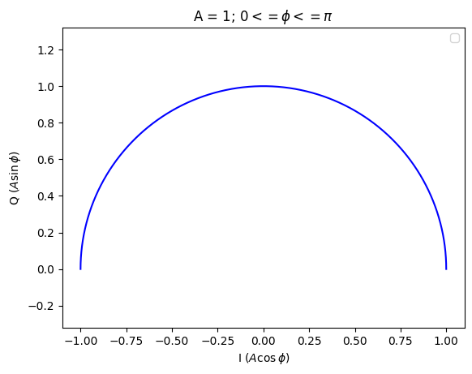
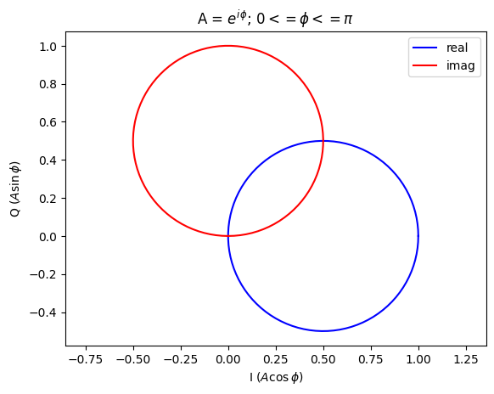
Why Do KID outputs form circles in I/Q space?
Notes:
see delta_fx_methods.ipynb
discussion with James on Slack: https://app.slack.com/client/T01F54RRGMU/D0879E46HPY

Slide 11
SPIRE / BLAST-TNG Diffs
Analyzing Imagery for RCW-92

Slide 12
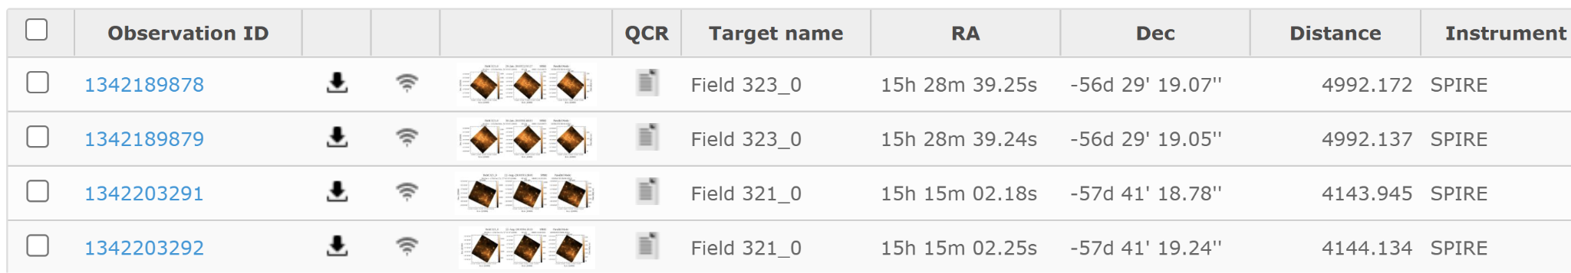
Obtaining SPIRE Data
https://archives.esac.esa.int/hsa/whsa/
4 sets at 250um, 350um and 500um each
Dated January 30, 2010
Includes two slightly different locations,

Slide 13
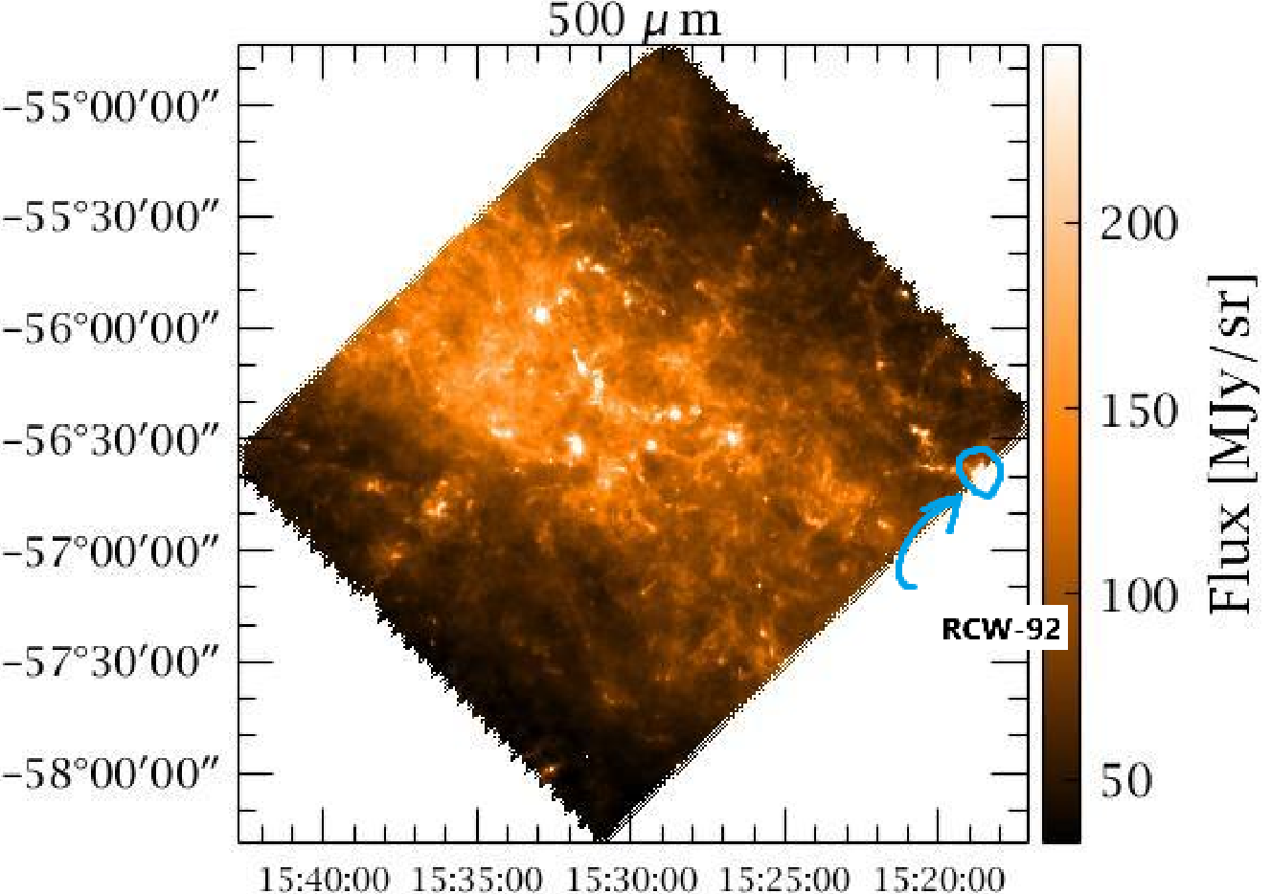
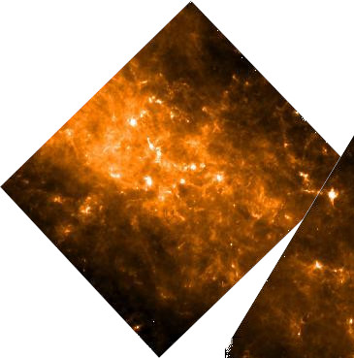
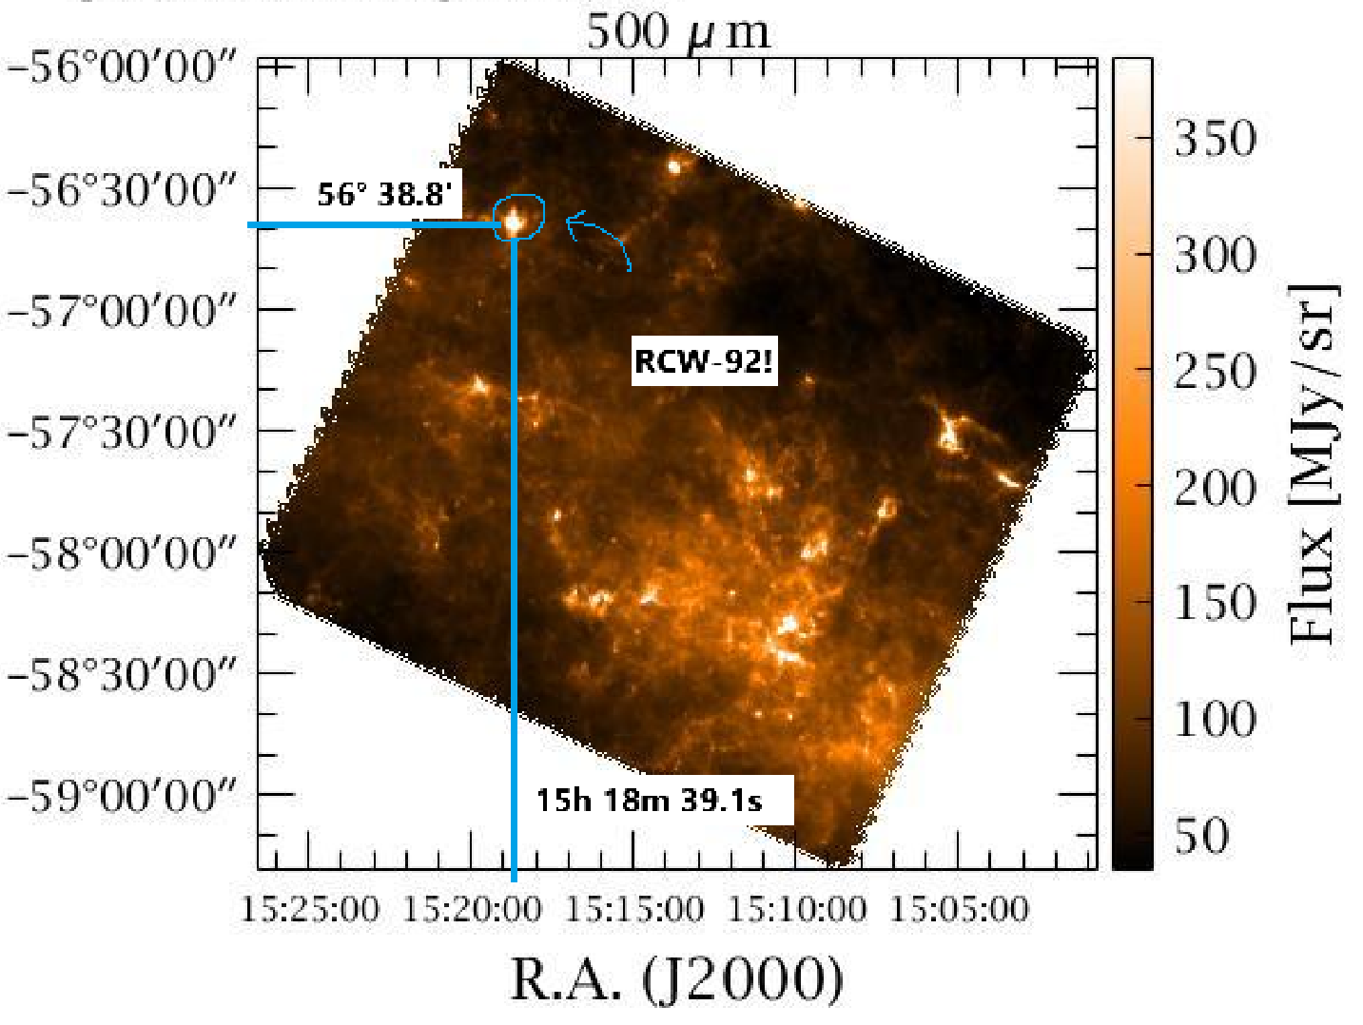
Locating RCW-92
SYMBAD: resolve coords
RA: 229.66292, Dec: -56.64694
convert RA: → 15h 18m 39.1s
convert Dec: → ~56° 38.8’
Top: Field 323_0
Bottom: Field 321_0
→ Since RCW-92 is cut off in field 323_0 scan, we will begin with field 321_0 data and combine more if needed
Overlayed

Slide 14
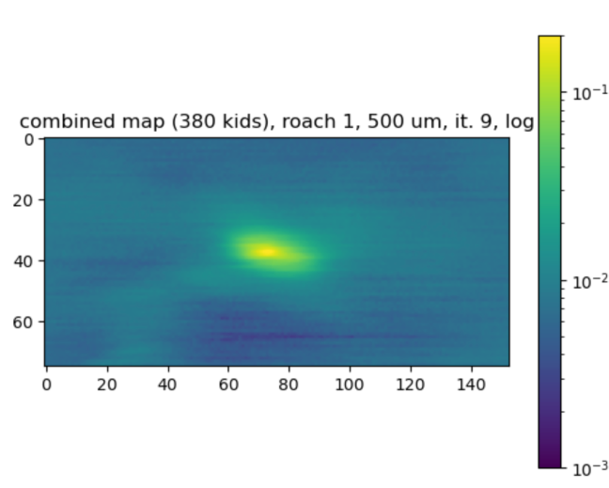
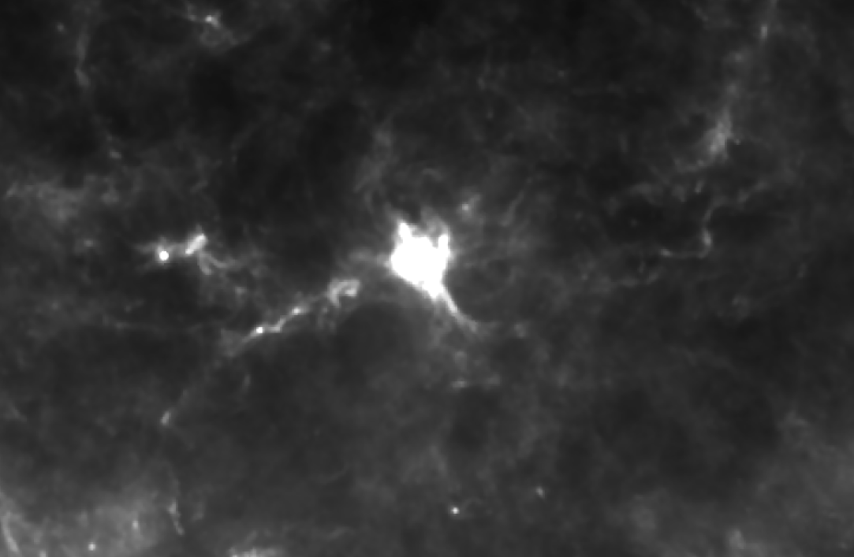
Exploring The Data
Data is organized into Data Levels 0-3, in increasing amount of processing
I started with Data Level 3, which contains extended combined maps
FITS files can be opened in GIMP
Dec.
RA
RCW-92, as seen in Observation Identifier (ObsId) #1342203291
Level 3 - “browseProduct”
(left img. rotated 30 deg such that x/y approximately correspond to RA/Dec)
BLAST-TNG Map of RCW-92, log scale
Source: James Burgoyne (slide 72)

Slide 15
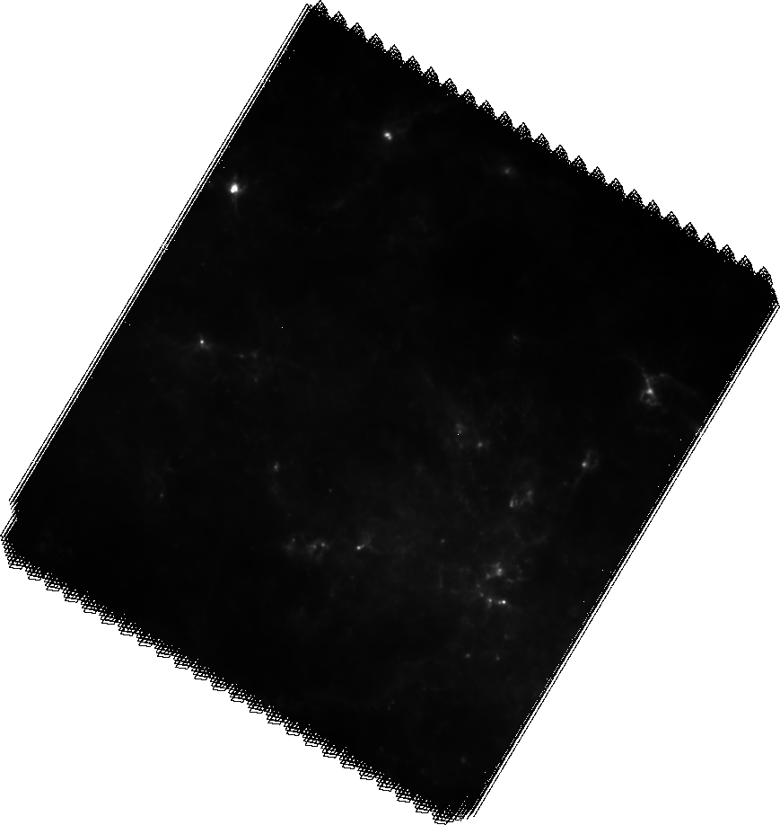
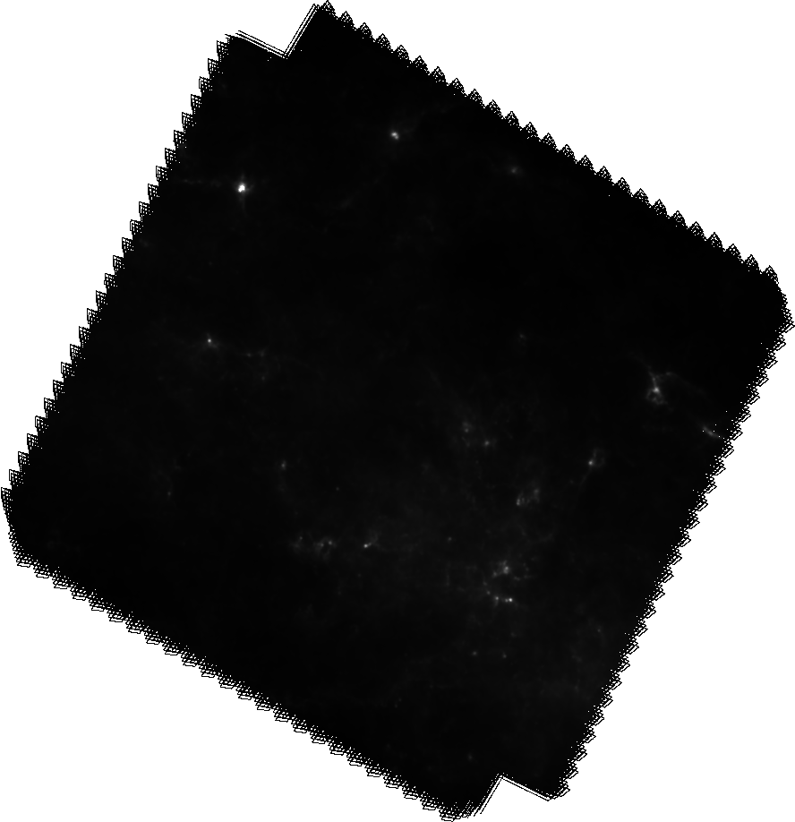
Exploring The Data
Level 2/2.5
PSW, PMW, PLW correspond to the 3 different bands
250um, 350um. 500um
We have both extended (extd) & point-source (psrc) calibrated products
Which to use? I don’t know.
Level 2.5 also has hi-res products, and combinations of nominal/orthogonal scans
left: obsid # 1342203292 extdPLW
right: combined
1342203291+1342203292
extdPLW
RCW-92

Slide 16
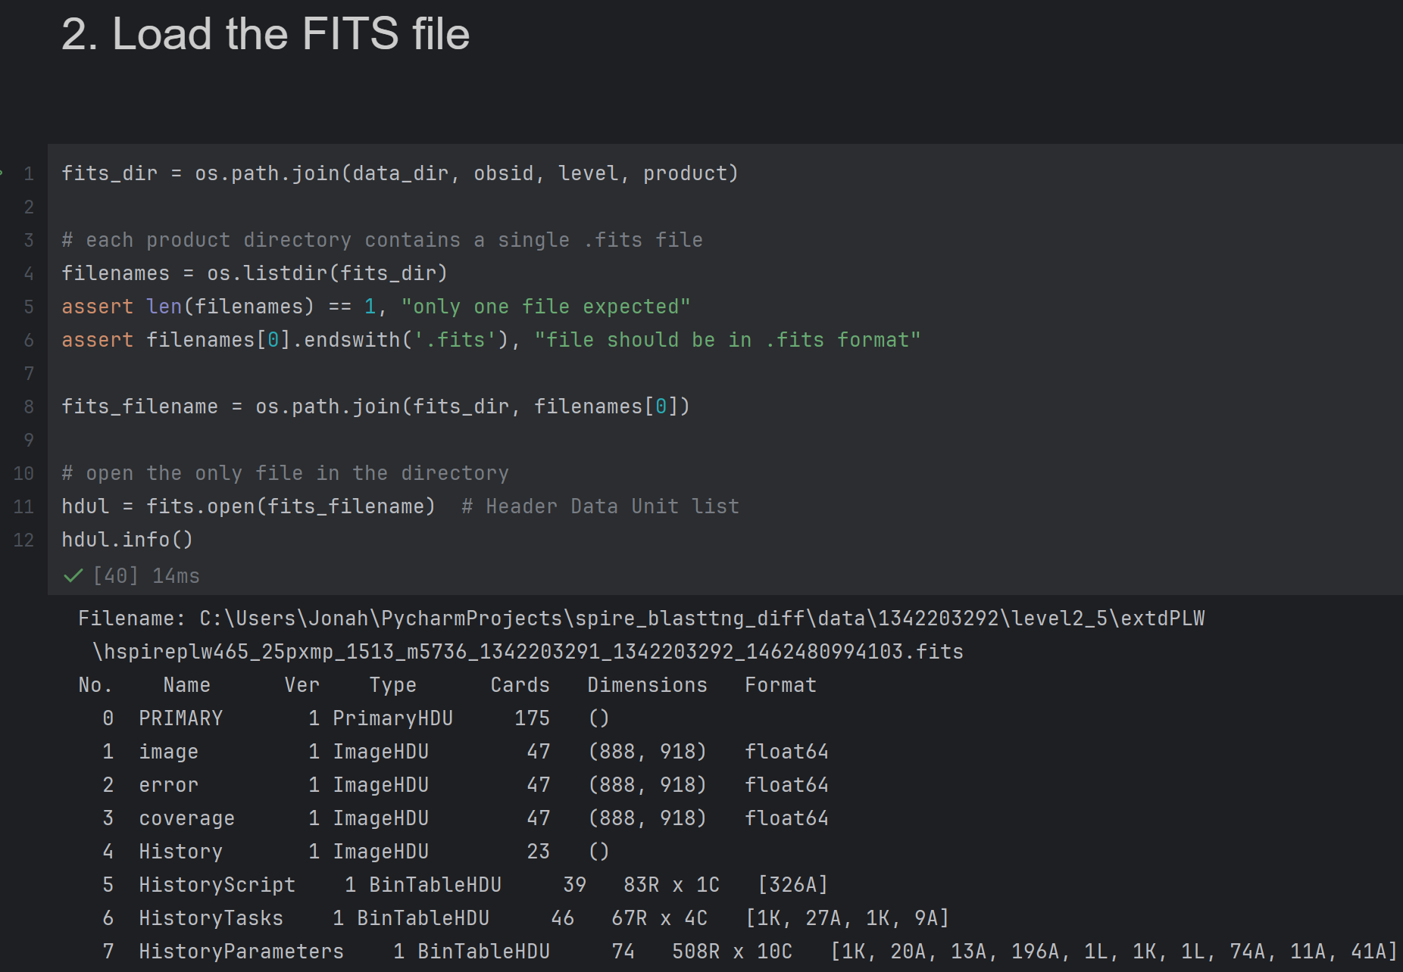
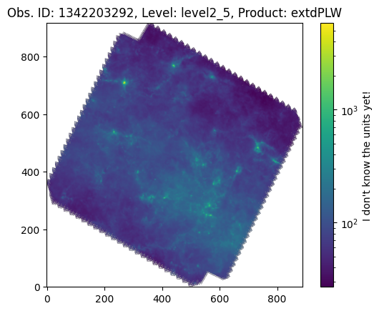
Working With .FITS Data With AstroPy

Slide 17
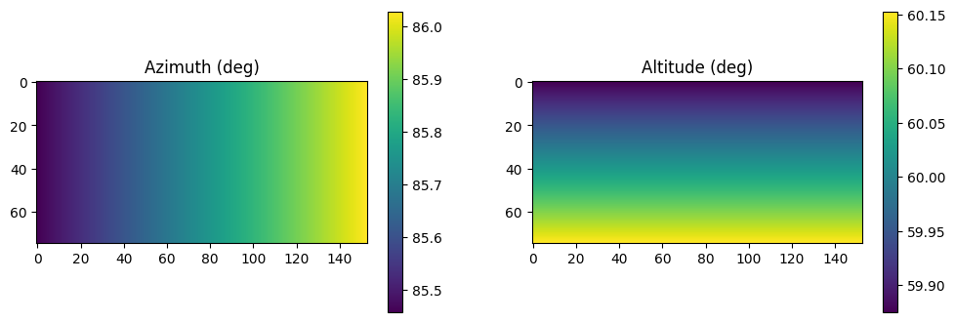
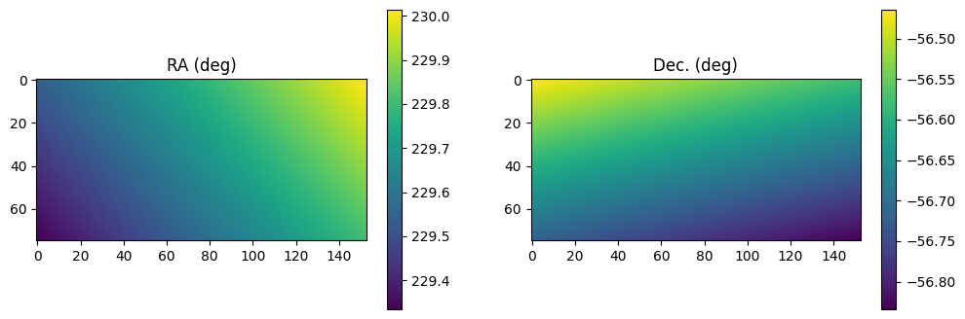
Converting Coordinates In Astropy
found the average location & time of the telescope during the RCW 92 slice
converted x/y um offsets to degrees using astropy projection
located RCW 92 in alt/az coords and added offsets to obtain alt/az per pixel (ignored time-dependence of conversion since the telescope doesn't travel very far)
used astropy to convert alt/az to RA/Dec. given time and location
sampled the SPIRE data at the obtained RA/Dec. per-pixel

Slide 18
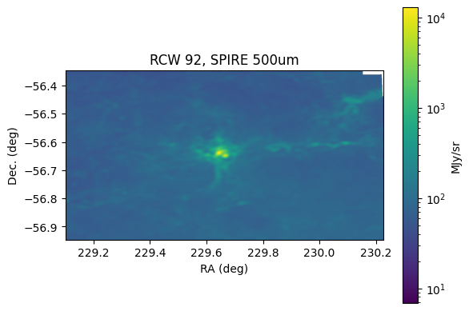
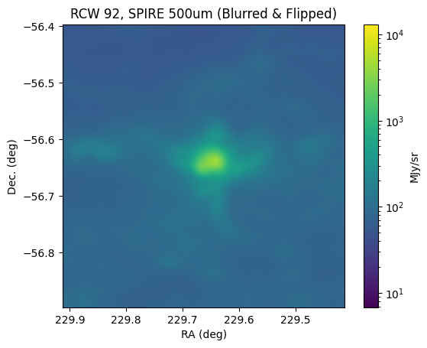
Astropy: Locating RCW 92 & Creating Cropped Views
I still haven’t determined the scale or orientation of this map

Slide 19
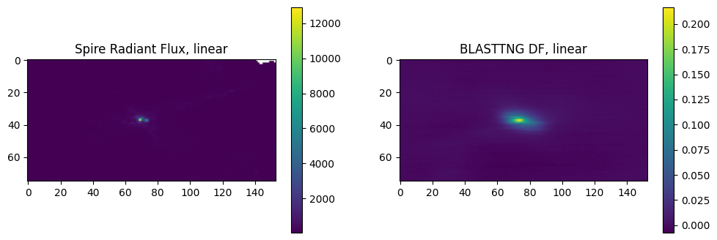
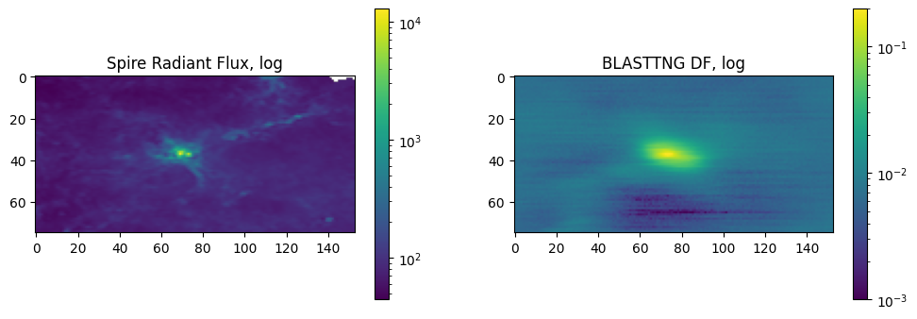
Results
(500um)

Slide 20
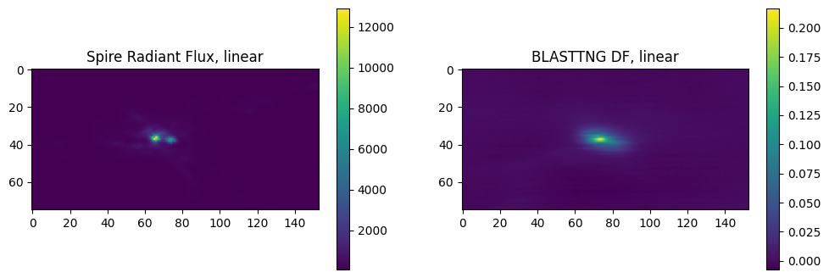
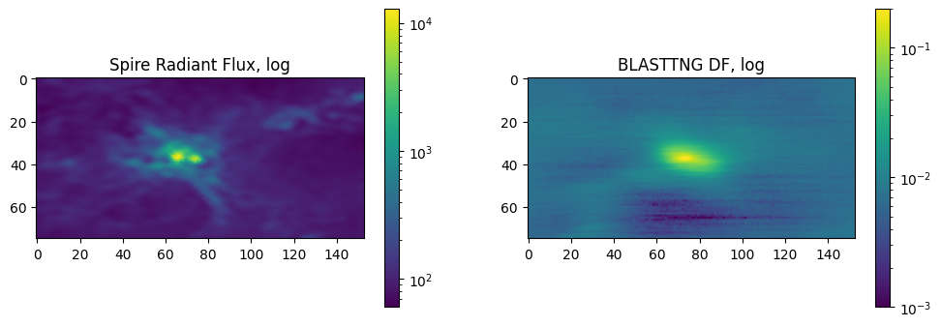
Off by a
factor
of 2?
Some
other
scaling?

Slide 21
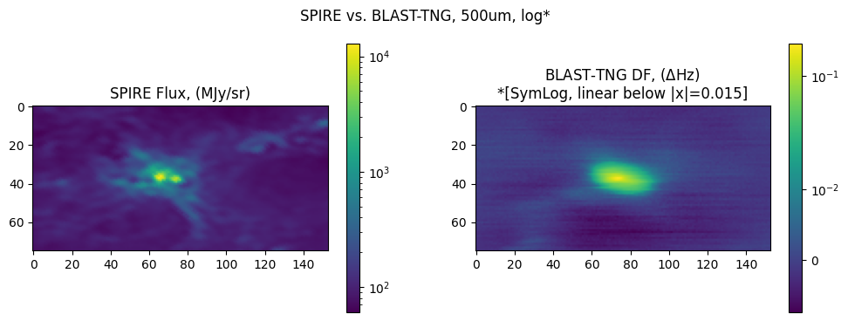
Results: spire_diff.ipynb

Slide 22
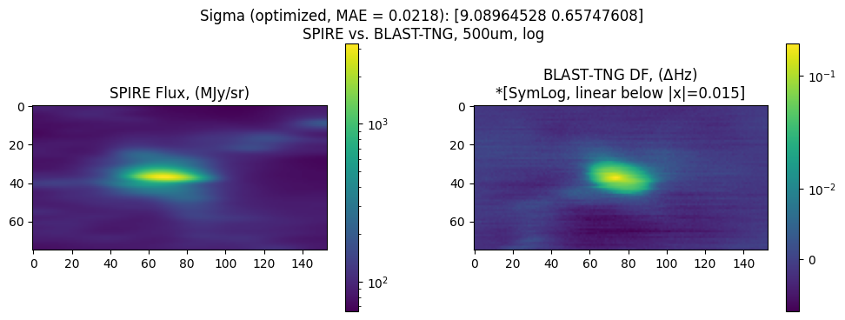
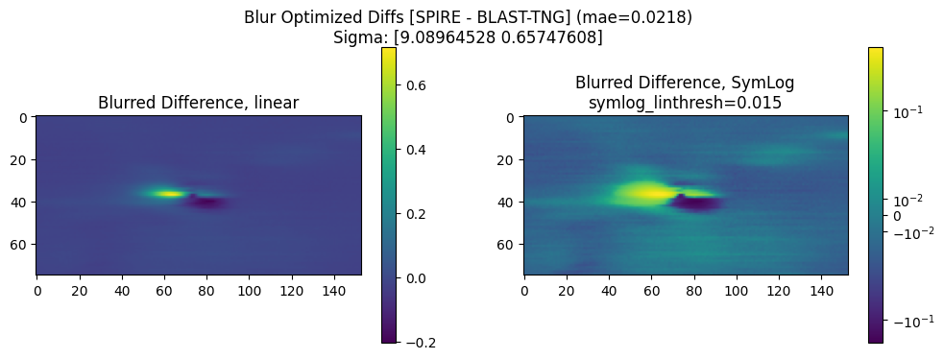
Gaussian Blur Optimization - Minimizing Mean Avg. Error

Slide 23
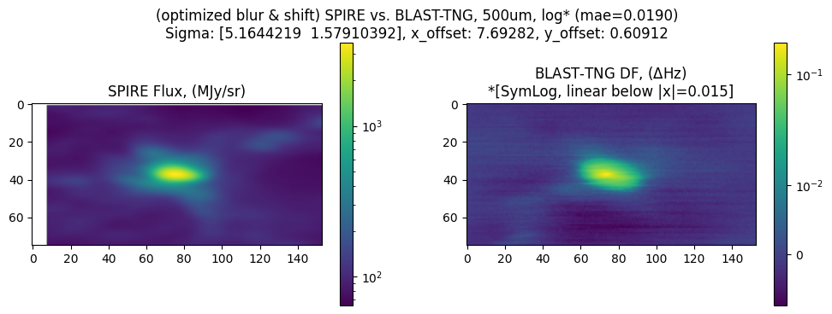
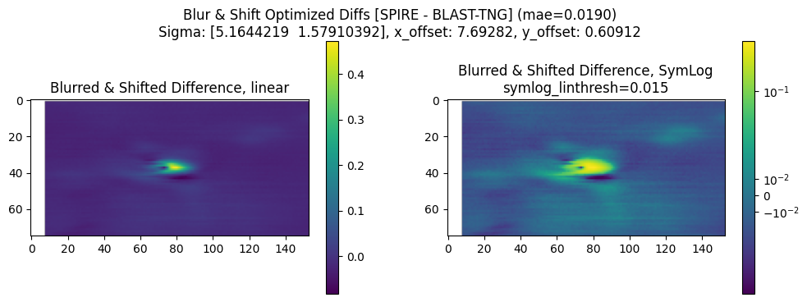
Further Fitting: Optimizing x/y Offset
Optimizing the offset & blur together lead to a smaller (softer) blurring, especially in x.
This result looks better, and the offset could be explained by the difference between the location of RCW-92 as per Astropy and the brightest pixel.
(The map maker assumes the brightest pixel is RCW-92.)

Slide 24
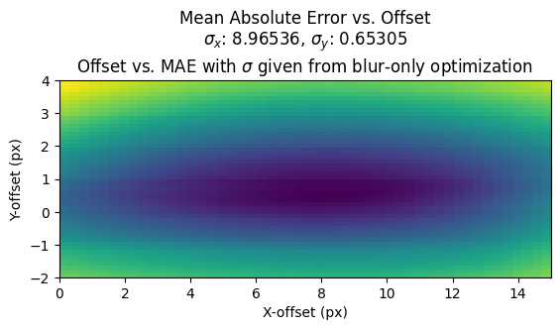
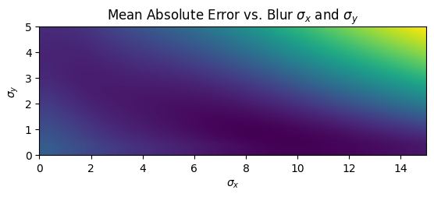
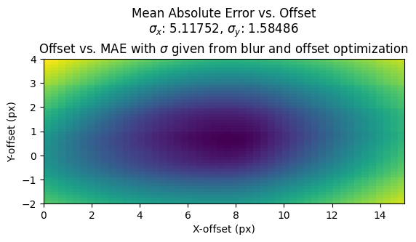
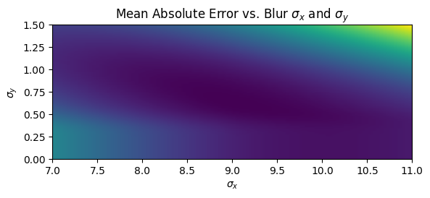
Plotting Error Functions

Slide 25
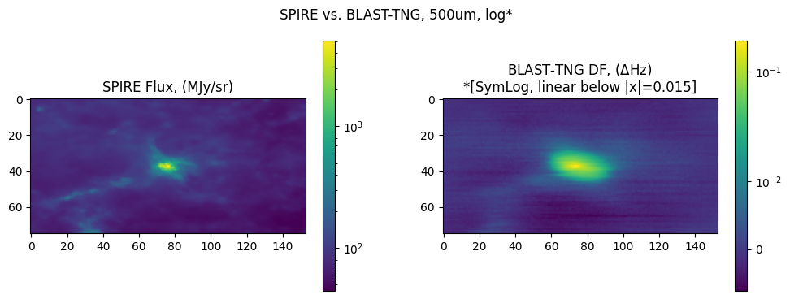
Error Discovered; Re-Analysis
I was not off by a factor of 2. Instead, my image was rotated 180 degrees.
The image was rotated because the um array offsets were the wrong sign
Note the change in SPIRE resolution - I also changed source data to remove the NaN region
Before:
After:

Slide 26
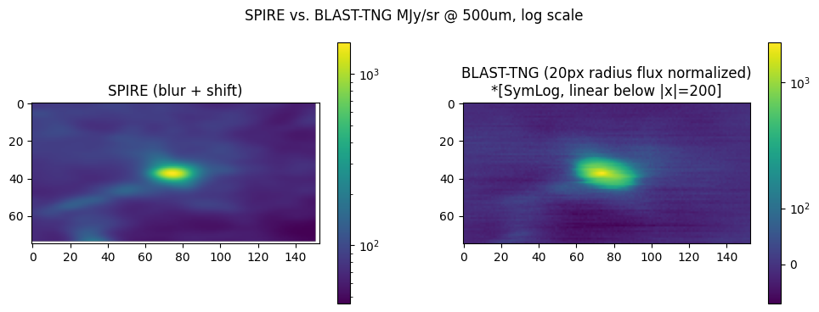
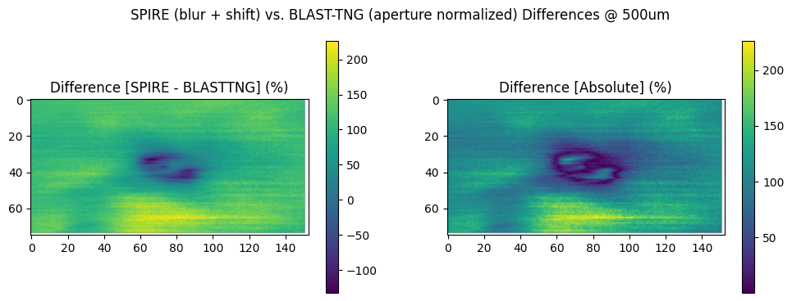
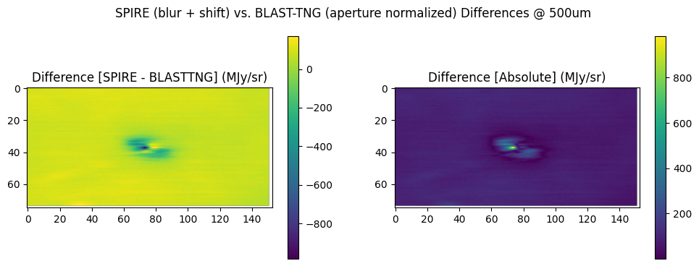
Improved Difference Images
This time, we clearly see the same shapes appearing. The offset and blur are also more minimal than previously.
(σ_{x}=4.6, σ_{y}=1.4, ΔX=-1, ΔY=-0.1)

Slide 27
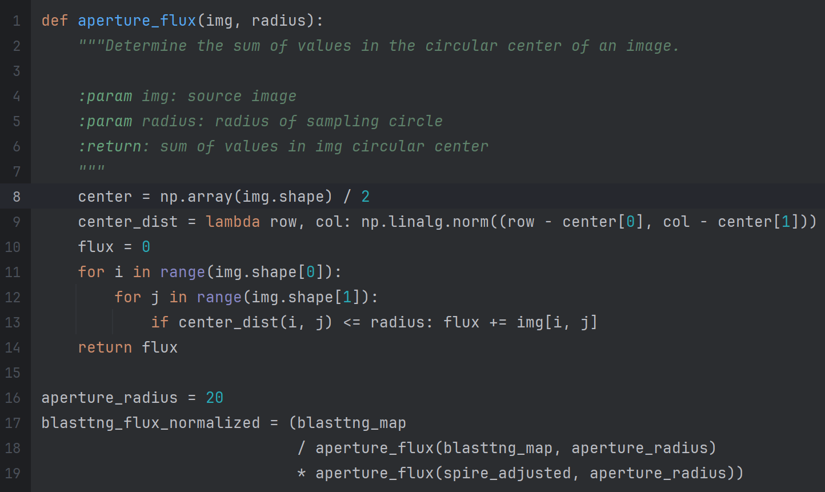
Improved Image Normalization
“Aperture Flux” Normalization - set the sum of pixel values around the source (flux) for BLAST-TNG to match SPIRE data.
Normalized this way, the BLAST-TNG images can be interpreted in terms of MJy/sr.

Slide 28
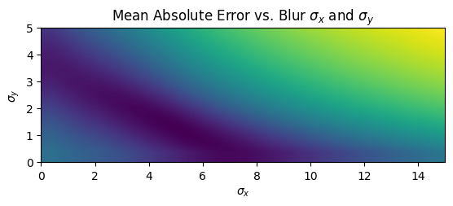
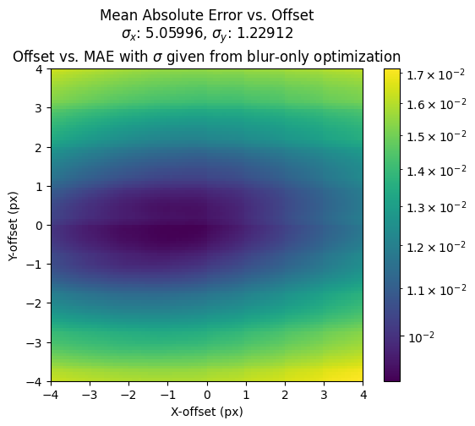
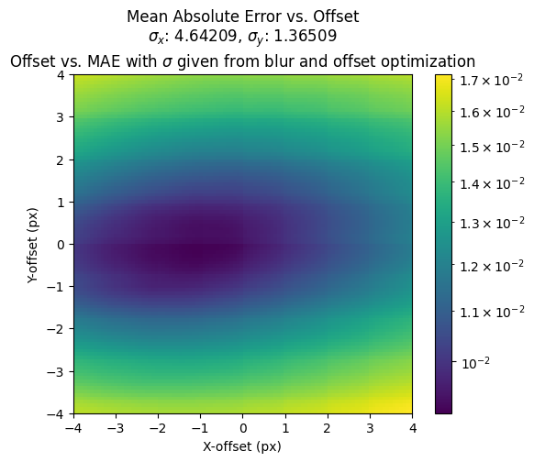
New Error Functions
Similar to before, we have a clear minimum which is a good sign. This time, the optima are minimal, meaning little adjustment was needed.

Slide 29
Possible Improvements
Rotating the elliptic blur (gaussian kernel)
This could be a 5th parameter for which to optimize
Applying some transformation function to the BLAST-TNG image to match the distribution
The images do well in that they show which regions are higher in magnitude and which are lower, but the “curves” do not appear to be 100% linear. We could apply an increasing mapping function to the BLAST-TNG image to make the histograms of each image match, and this should correct for any non-linearity.

Slide 30
